Slide 1
Ad Click Simulations
Russell Kim

Slide 2
Background
Advertisements exist around us, everywhere
Google is a great place for companies to advertise their products
Google’s system includes a campaign.
A campaign is a group of ads for different categories of products/services.
A click is when a consumer clicks on an ad.
A bid is a value that a company is willing to bid on an auction.

Slide 3
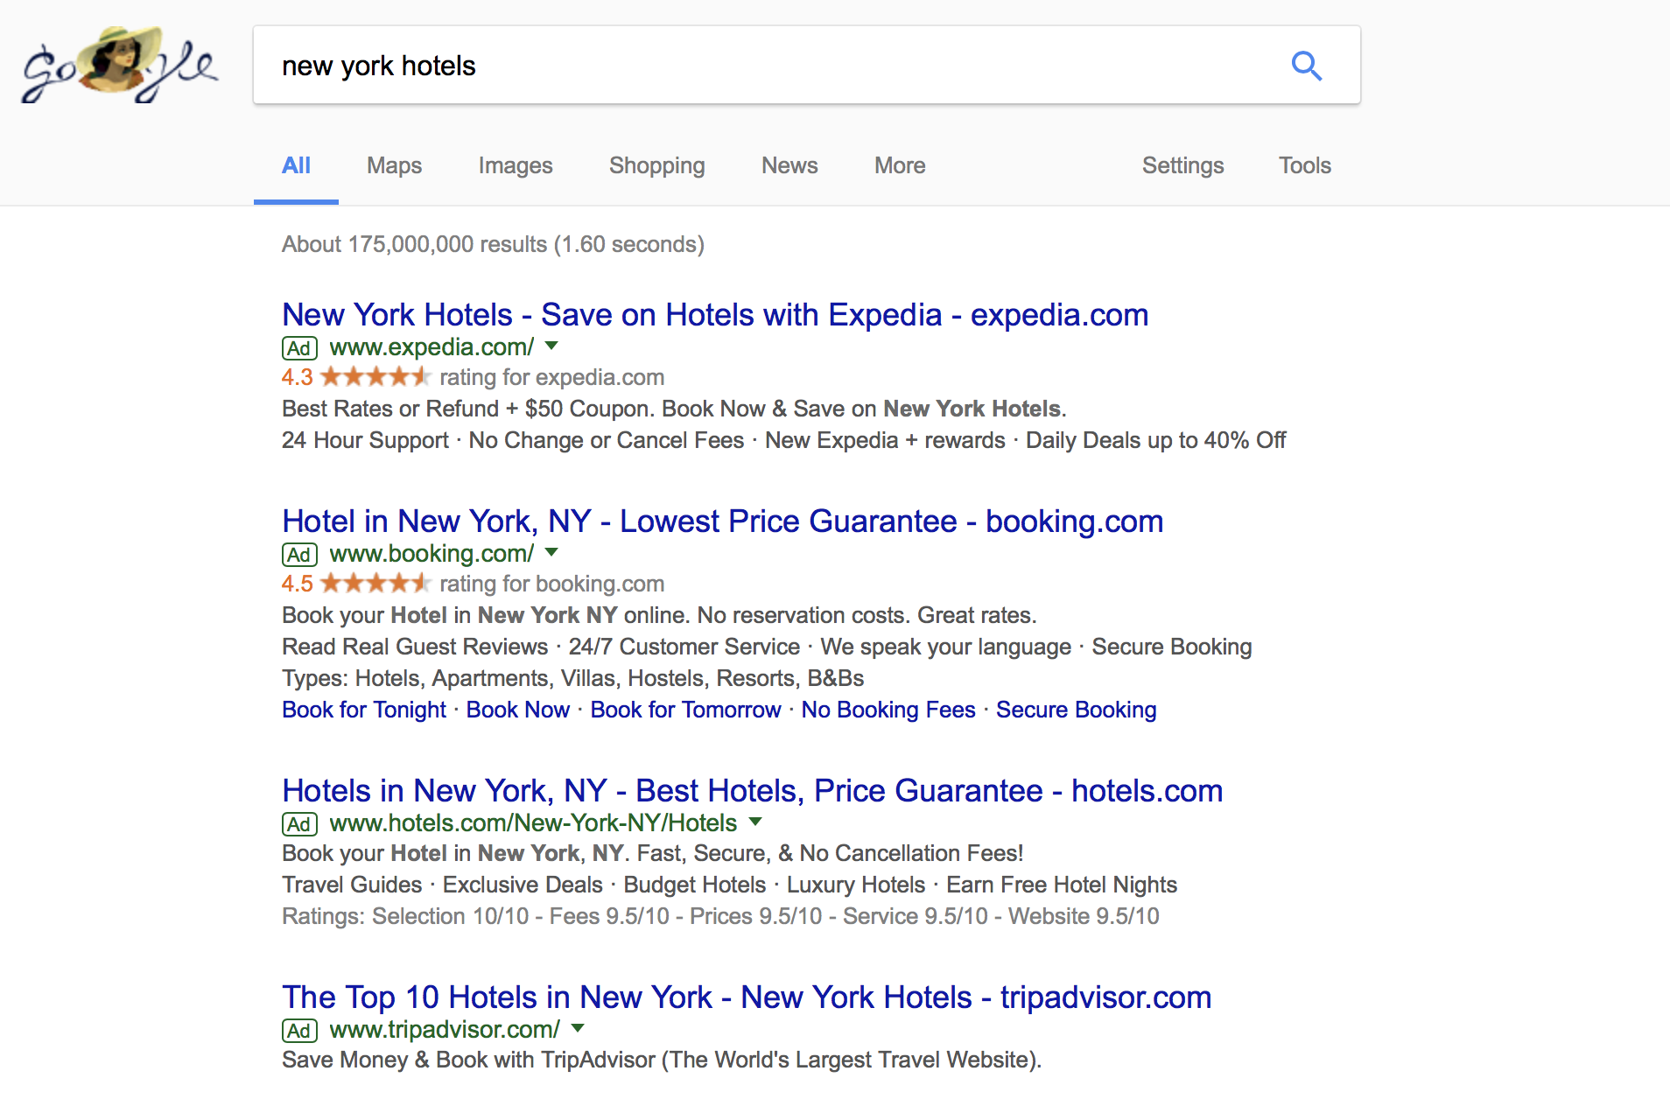

Slide 4
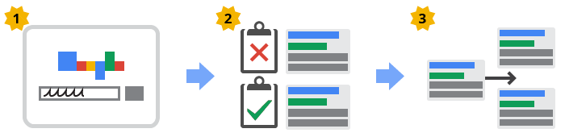
How it works
1. The search
2. Ads are whittled down
3. Ads whittled even more

Slide 5

How it works, cont.
4. Ads are ordered
5. Ads appear!
6. Repeat the process

Slide 6
Problem
How do we create a strategy of bidding(called a policy) that maximizes profit?
My part: in order to test this policy out, we need a simulator that simulates real world behavior.

Slide 7

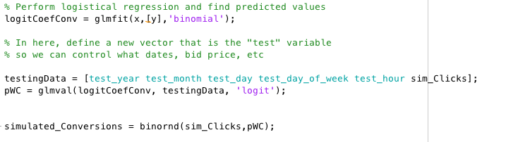
First attempt
Read in all data from the dataset(note, all bid values are $7)
Average these values
# of auctions, cost per click, number of clicks, and the expected value of a click
Simulate the following
Auctions
Poisson distribution
Clicks, conversions, Impressions
Simulate Clicks, Conversions the same way
This strategy used only past data to generate simulations - no policies involved

Slide 8
Current version
Simulator initializes policies
Run simulation with policies loaded
Get initial bid values
Simulate number of auctions
For each auction, simulate number of clicks
Provide # of clicks and # of auctions and provide to the learner policy
1 Hour(Repeat as needed)

Slide 9
Going through each step in detail - Initializing the simulation
There are four adjustable values, or “settings”
The Location constant
Numbers from 1-100 for Country, Region, City
Theta value
Tau
Time Horizon

Slide 10
Loading the Policies
Call the initializing function, receive vectors
Test different types of policies

Slide 11
Get initial bid
Get a bid value by calling a policy function that takes in the vector values provided by the initializing function

Slide 12
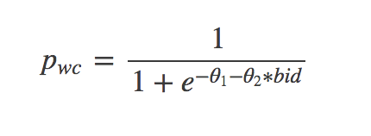
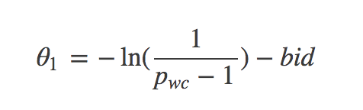
Before we get started
Few more things to do:
Get the historical probability of getting a click from an auction for each hour
P = clicks/hour
Solving for the first theta, we get

Slide 13
Before we get started, cont.
After solving for the first theta, calculate those values for every single hour using the probability(which we have calculated as shown before)
Recall that the bid value is 7 for this particular data set
Make up a random value for the second theta value(most meaningful values come between -1 and -3
Set a probability for changing the truth
Ex. if p = 0.9, the truth will change about every 10 hours

Slide 14
Simulate the number of auctions for each hour
Before looping over each hour, we preprocess the historical data
For every 168th hour, grab the number of auctions run and take the mean
Put these 168 values into a vector
Sample from a poisson distribution with the corresponding number of auctions as the λ in poissonrnd(λ)
Pick the winning bid - the highest bid
If there is a tie, break it randomly

Slide 15
Simulate clicks
For each auction:
Use this logit function to find the probability of a click
Run a binomial trial with this probability
Here we initialize a randstream so that we are able to reproduce results, even when the functions rely on random sampling

Slide 16
Update learner policy
Provide # of auctions, clicks, and other vectors to the learner policy to update
Loop for desired number of hours

Slide 17
Design of the simulator
Matlab is a struggle - hard to design programs in a way that provides encapsulation
We pass data from the policies through the simulator so that it is possible to call several policies at the same time and directly compare them
The simulator directly makes it so that the contents of all the different policies are irrelevant
Modular and flexible like Java or Python

Slide 18
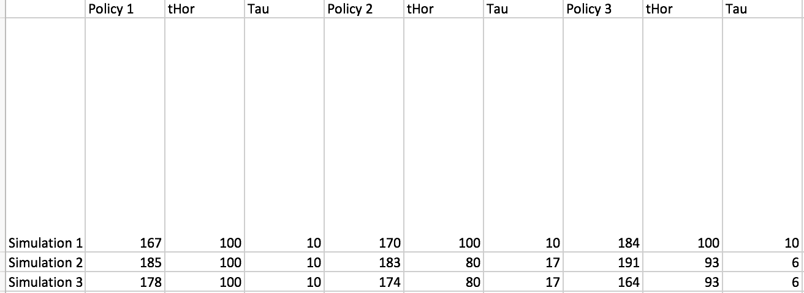
Results - averages after running 10 simulations

Slide 19
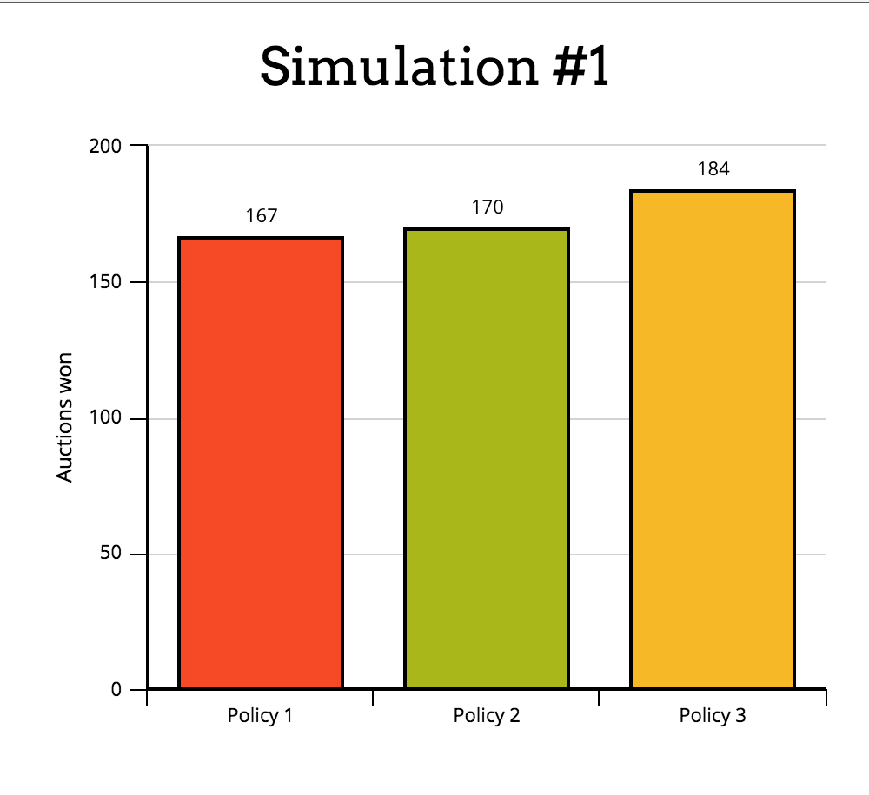
Visualized data

Slide 20
